Slide 1
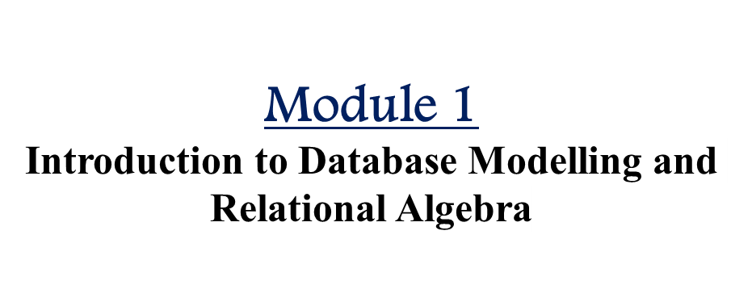
CSE2260 - Database Management Systems

Slide 2
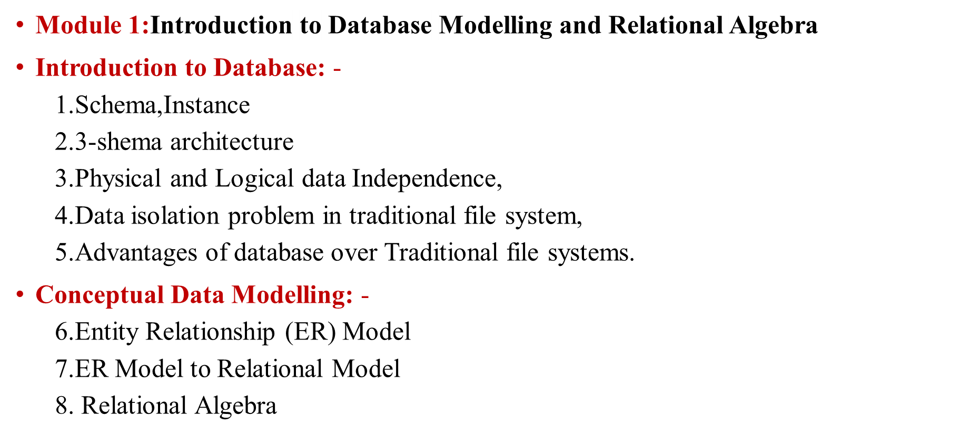

Slide 3
Definitions
Data: Raw facts, Unprocessed facts or Known facts that can be recorded and have an implicit meaning.
Ex: 25, suresh, Bangalore
  Structured: numbers, text, dates
  Unstructured: images, video, documents
Information: Processed Data
  Ex: The age of Suresh is 25

Slide 4
Basic Definitions
Database: A collection of related data.
Data: Known facts that can be recorded and have an implicit meaning.
Mini-world: Some part of the real world about which data is stored in a database. For example, student grades and transcripts at a university.
Database Management System (DBMS): A software package/ system to facilitate the creation and maintenance of a computerized database.
Database System: The DBMS software together with the data itself. Sometimes, the applications are also included.
Slide 1-<number>

Slide 5
Definitions
  Database:
Def 1: Database is an organized collection of logically related data
Def 2: A database is a shared collection of logically related data that is stored to meet the requirements of different users of an organization
Def 3: A database is a self-describing collection of integrated records
Def 4: A database models a particular real world system in the computer in the form of data
  Ex: Online banking system, Library Management
Slide 1-<number>

Slide 6
What is DBMS ?
The DBMS provides users and programmers a systematic way to create, retrieve, update and manage database. or
A software package/ system to facilitate the creation and maintenance of a computerized database.
Database System:
The DBMS software together with the data itself. Sometimes, the applications are also included.

Slide 7
Advantages
Multiple user interfaces
Redundancy control
Backup and Recovery
Authorized Access

Slide 8
Main Characteristics of the Database Approach
Self-describing nature of a database system
Insulation between programs and data
Data Abstraction
Notes:
Self-describing nature of a database system: A DBMS catalog stores the description of the database. The description is called meta-data. This allows the DBMS software to work with different databases.
Insulation between programs and data: Called program-data independence. Allows changing data storage structures and operations without having to change the DBMS access programs.
Data Abstraction: A data model is used to hide storage details and present the users with a conceptual view of the database.

Slide 9
Main Characteristics of the Database Approach
Support of multiple views of the data
Sharing of data and multiuser transaction processing
Notes:
Support of multiple views of the data: Each user may see a different view of the database, which describes only the data of interest to that user.
Sharing of data and multiuser transaction processing : allowing a set of concurrent users to retrieve and to update the database. Concurrency control within the DBMS guarantees that each transaction is correctly executed or completely aborted. OLTP (Online Transaction Processing) is a major part of database applications.

Slide 10
Types of Databases and Database Applications
Numeric and Textual Databases
Multimedia Databases
Geographic Information Systems (GIS)
Data Warehouses
Real-time and Active Databases

Slide 11
Database Users
Users may be divided into those who actually use and control the content (called “Actors on the Scene”) and those who enable the database to be developed and the DBMS software to be designed and implemented (called “Workers Behind the Scene”).

Slide 12
Database Users
Actors on the scene
  Database administrators
  Database Designers
  End-users

Slide 13
Categories of End-users
Casual
Naïve or Parametric
Sophisticated
Stand-alone

Slide 14
Workers behind the Scene
DBMS system designers and implementers
Tool developers
Operators and maintenance personnel

Slide 15
Advantages of Using the Database Approach
Controlling redundancy in data storage and in development and maintenance efforts.
Sharing of data among multiple users.
Restricting unauthorized access to data.
Providing persistent storage for program Objects .
Providing Storage Structures for efficient Query Processing
Providing backup and recovery services.
Providing multiple interfaces to different classes of users.
Representing complex relationships among data.
Enforcing integrity constraints on the database.
Drawing Inferences and Actions using rules

Slide 16
Additional Implications of Using the Database Approach
Potential for enforcing standards
Reduced application development time
Flexibility to change data structures
Availability of up-to-date information
Economies of scale
Notes:
Potential for enforcing standards: This is very crucial for the success of database applications in large organizations Standards refer to data item names, display formats, screens, report structures, meta-data (description of data) etc.
Reduced application development time: Incremental time to add each new application is reduced.
Flexibility to change data structures: database structure may evolve as new requirements are defined.
Availability of up-to-date information – very important for on-line transaction systems such as airline, hotel, car reservations.
Economies of scale: by consolidating data and applications across departments wasteful overlap of resources and personnel can be avoided.

Slide 17
Data Models
Data Model: A set of concepts to describe the structure of a database, and certain constraints that the database should obey.
Data Model Operations: Operations for specifying database retrievals and updates by referring to the concepts of the data model. Operations on the data model may include basic operations and user-defined operations.

Slide 18
Data Models
Data Model gives us an idea that how the final system will look like after its complete implementation.
It defines the data elements and the relationships between the data elements.
Data Models are used to show how data is stored, connected, accessed and updated in the database management system.
Here, we use a set of symbols and text to represent the information so that members of the organization can communicate and understand it.

Slide 19
Categories of data models
Conceptual (high-level, semantic) data models: Provide concepts that are close to the way many users perceive data. (Also called entity-based or object-based data models.)
Physical (low-level, internal) data models: Provide concepts that describe details of how data is stored in the computer.
Implementation (representational) data models: Provide concepts that fall between the above two, balancing user views with some computer storage details.

Slide 20
Some of the Data Models in DBMS are:
  Hierarchical Model
  Network Model
  Entity-Relationship Model
  Relational Model
  Object-Oriented Data Model
  Object-Relational Data Model
  Flat Data Model
  Semi-Structured Data Model
  Associative Data Model
  Context Data Model

Slide 21
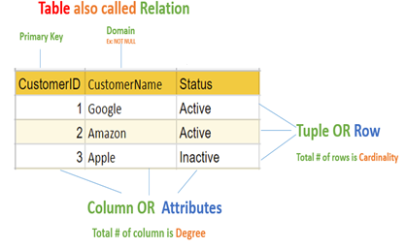
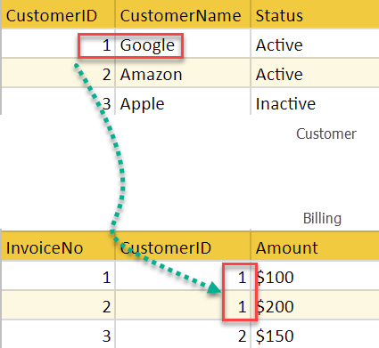
Relational Model
The relational model represents the database as a collection of relations.
A relation is nothing but a table of values.
Every row in the table represents a collection of related data values.
These rows in the table denote a real-world entity or relationship.

Slide 22
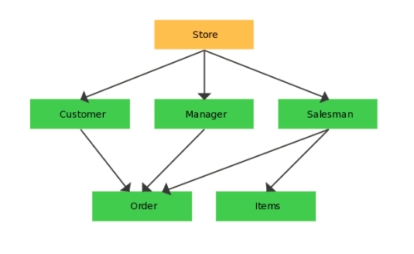
Network model
Is a database model that is designed as a flexible approach to representing objects and their relationships.
A unique feature of the network model is its schema, which is viewed as a graph where relationship types are arcs and object types are nodes.

Slide 23
Network Model
ADVANTAGES:
  Network Model is able to model complex relationships and represents semantics of add/delete on the relationships.
  Can handle most situations for modeling using record types and relationship types.
DISADVANTAGES:
  Navigational and procedural nature of processing
  Database contains a complex array of pointers that thread through a set of records. Little scope for automated "query optimization”

Slide 24
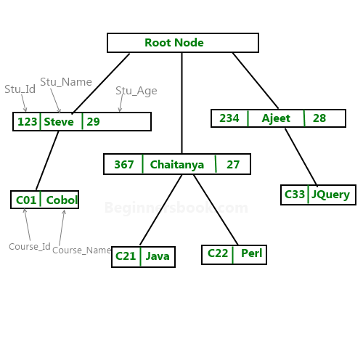
Hierarchical database model
Is a data model in which the data are organized into a tree-like structure. The data are stored as records which are connected to one another through links. A record is a collection of fields, with each field containing only one value. The type of a record defines which fields the record contains.
The hierarchical database model mandates that each child record has only one parent, whereas each parent record can have one or more child records

Slide 25
Hierarchical Model
ADVANTAGES:
  It promotes data sharing.
  Parent/child relationship
  Promotes conceptual simplicity.
  Database security is provided and enforced by DBMS.
  Parent/child relationship promotes data integrity.
  It is efficient with 1:M relationships.

Slide 26
Hierarchical Model
  DISADVANTAGES:
  Complex implementation requires knowledge of physical data storage characteristics.
  Navigational system yields complex application development, management, and use; requires knowledge of hierarchical path.
  Changes in structure require changes in all application programs.
  There are implementation limitations (no multiparent or M:N relationships).
  There is no data definition or data manipulation language in the DBMS.

Slide 27
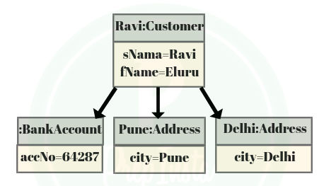
Object Oriented (OO) Data Model
Increasingly complex real-world problems demonstrated a need for a data model that more closely represented the real world. In the object oriented data model (OODM), both data and their relationships are contained in a single structure known as an object.

Slide 28
Object relational model
Is a combination of a Object oriented database model and a Relational database model. So, it supports objects, classes, inheritance etc. just like Object Oriented models and has support for data types, tabular structures etc. like Relational data model.
One of the major goals of Object relational data model is to close the gap between relational databases and the object oriented practices frequently used in many programming languages such as C++, C#, Java etc.
Both Relational data models and Object oriented data models are very useful. But it was felt that they both were lacking in some characteristics and so work was started to build a model that was a combination of them both.

Slide 29
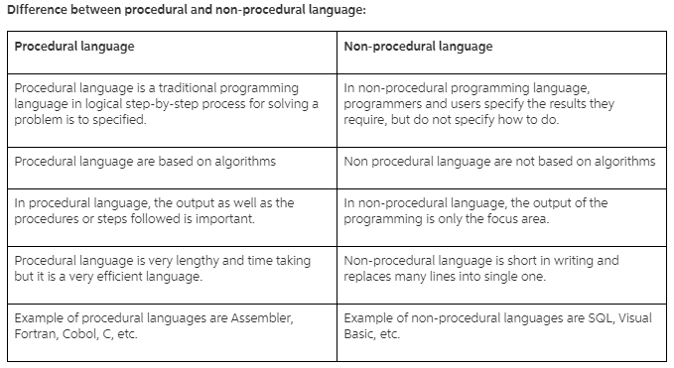
DBMS Languages

Slide 30
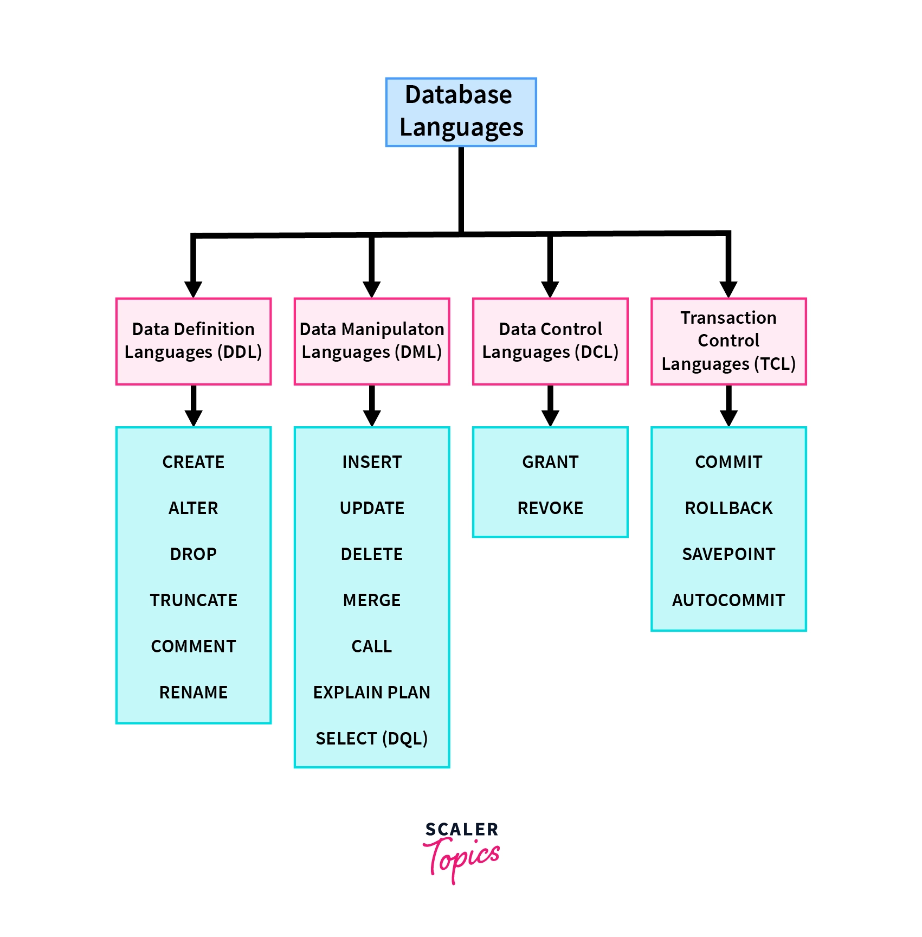
Types of DBMS languages:

Slide 31
Data Definition Language (DDL)
DDL is used for specifying the database schema.
It is used for creating tables, schema, indexes, constraints etc. in database.
    CREATE
    ALTER
    DROP
    TRUNCATE
    RENAME
    DROP
    Comment

Slide 32
Data Manipulation Language (DML)
DML is used for accessing and manipulating data in a database. The following operations on database comes under DML:
  SELECT
  INSERT
  UPDATE
  DELETE

Slide 33
Data Control language (DCL)
DCL is used for granting and revoking user access on a database –
  GRANT
  REVOKE

Slide 34
Transaction Control Language(TCL)
The changes in the database that we made using DML commands are either performed or roll backed using TCL.
  COMMIT
  ROLLBACK

Slide 35
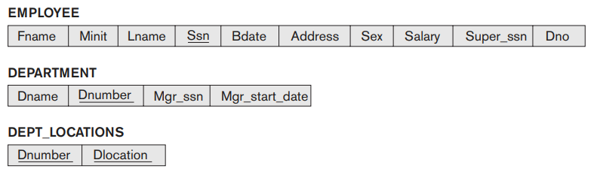
1.Schemas, Instances, and Database State
Database Schema
A database schema is the logical representation of a database, which shows how the data is stored logically in the entire database.
Employee Schema
Department Schema
Dept_Location Schema

Slide 36
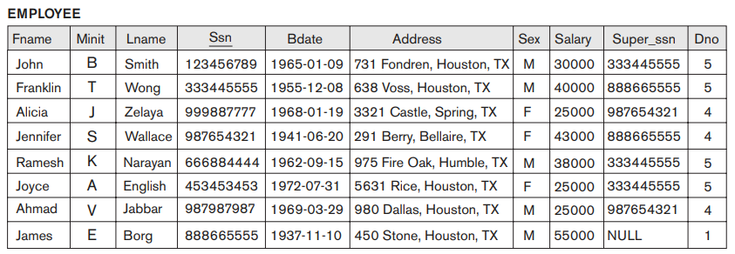
Schemas, Instances, and Database State
Instances
The instance of the database is the values of these variables or attributes at any given time
Employee Schema
Instances

Slide 37
Schemas, Instances, and Database State
Database State
The data in the database at a particular moment in time is called a database state or snapshot.

Slide 38
Schemas versus Instances
Database Schema
Schema Diagram
Schema Construct
Database Instance

Slide 39
Database Schema Vs. Database State
Database State: Refers to the content of a database at a moment in time.
Initial Database State: Refers to the database when it is loaded
Valid State: A state that satisfies the structure and constraints of the database.
Distinction
  The database schema changes very infrequently. The database state changes every time the database is updated.
  Schema is also called intension, whereas state is called extension.

Slide 40
Example: University Database
Conceptual schema:
  Students(sid: string, name: string, login: string, age: integer, gpa:real)
  Courses(cid: string, cname:string, credits:integer)
  Enrolled(sid:string, cid:string, grade:string)
Physical schema:
  Relations stored as unordered files.
  Index on first column of Students.
External Schema (View):
  Course_info(cid:string,enrollment:integer)
Notes:
7

Slide 41
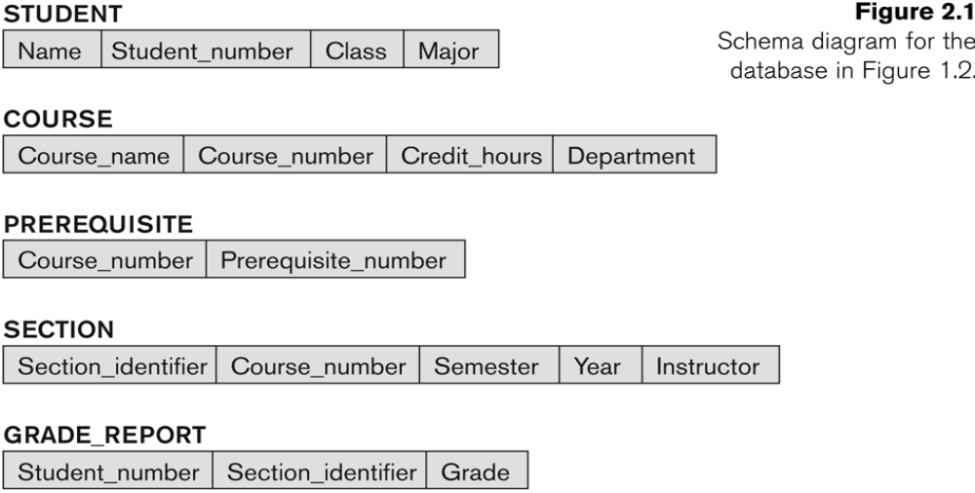
Example of a Database Schema

Slide 42
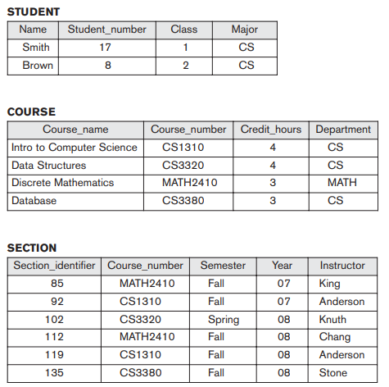
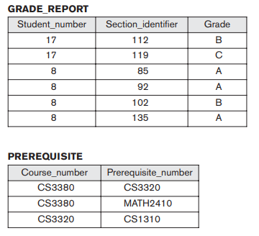
Example of a database state

Slide 43

2.Three-Schema Architecture

Slide 44
Three-Schema Architecture
Defines DBMS schemas at three levels:
Internal schema
Conceptual schema
External schemas

Slide 45
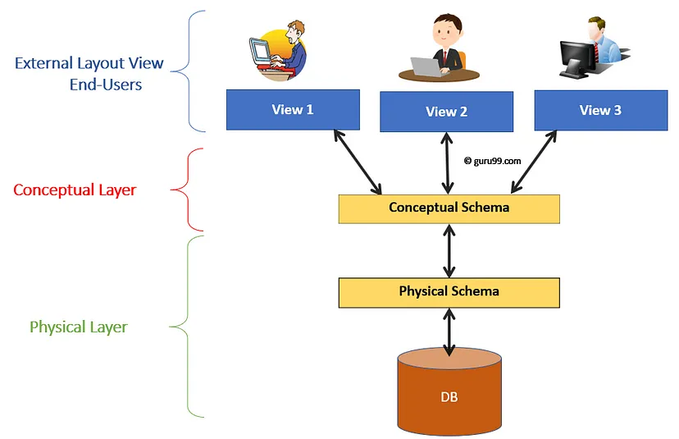
Type of Schema | Implementation
External Schema | View 1: Course info(cid:int,cname:string) View 2: studeninfo(id:int. name:string)
Conceptual Shema | Students(id: int, name: string, login: string, age: integer) Courses(id: int, cname.string, credits:integer) Enrolled(id: int, grade:string)
Physical Schema | Relations stored as unordered files. Index on the first column of Students.

Slide 46
Three-Schema Architecture
Three-Schema Architecture is Proposed to support DBMS characteristics of:
  Program-data independence.
  Support of multiple views of the data.

Slide 47
3.Data Independence
When a schema at a lower level is changed, only the mappings between this schema and higher-level schemas need to be changed in a DBMS that fully supports data independence.
The higher-level schemas themselves are unchanged. Hence, the application programs need not be changed since they refer to the external schemas.

Slide 48
Data Independence:
We can define two types of data independence:
Logical Data Independence
Physical Data Independence

Slide 49
4.What is a File system?
A file system is a technique of arranging the files in a storage medium like a hard disk, pen drive, DVD, etc.
It mostly consists of different types of files like mp3, mp4, txt, doc, etc. that are grouped into directories.

Slide 50
Drawbacks of File system
Data redundancy: Data redundancy refers to the duplication of data, lets say we are managing the data of a college where a student is enrolled for two courses, the same student details in such case will be stored twice, which will take more storage than needed. Data redundancy often leads to higher storage costs and poor access time.
Data inconsistency: Data redundancy leads to data inconsistency, lets take the same example that we have taken above, a student is enrolled for two courses and we have student address stored twice, now lets say student requests to change his address, if the address is changed at one place and not on all the records then this can lead to data inconsistency.

Slide 51
Cont..
Data Isolation: Because data are scattered in various files, and files may be in different formats, writing new application programs to retrieve the appropriate data is difficult.
Dependency on application programs: Changing files would lead to change in application programs.

Slide 52
Cont..
Atomicity issues: Atomicity of a transaction refers to “All or nothing”, which means either all the operations in a transaction executes or none.
It is difficult to achieve atomicity in file processing systems.
Data Security: Data should be secured from unauthorised access, for example a student in a college should not be able to see the payroll details of the teachers, such kind of security constraints are difficult to apply in file processing systems.

Slide 53
5.File Systems Vs Database System
A file system is a software that manages and organizes the files in a storage medium, whereas DBMS is a software application that is used for accessing, creating, and managing databases.
The file system doesn't have a crash recovery mechanism on the other hand, DBMS provides a crash recovery mechanism.
Data inconsistency is higher in the file system. On the contrary Data inconsistency is low in a database management system.
File system does not provide support for complicated transactions, while in the DBMS system, it is easy to implement complicated transactions using SQL.
File system does not offer concurrency, whereas DBMS provides a concurrency facility.

Slide 54
Data Modelling using Entities and Relationships
Chapter-2

Slide 55
Outline
Using High-Level Conceptual Data Models for Database Design
A Sample Database Application
Entity Types, Entity Sets, Attributes, and Keys
Relationship Types, Relationship Sets, Roles, and Structural Constraints
Weak Entity Types
Refining the ER Design for the COMPANY Database
ER Diagrams, Naming Conventions, and Design Issues
Example of Other Notation: UML Class Diagrams
Relationship Types of Degree Higher than Two

Slide 56
1.Data Modeling Using the Entity-Relationship (ER) Model
Entity-Relationship (ER) model
  Popular high-level conceptual data model
ER diagrams
  Diagrammatic notation associated with the ER model

Slide 57
Using High-Level Conceptual Data Models for Database Design
Requirements collection and analysis
  Database designers interview prospective database users to understand and document data requirements
  Result: data requirements
  Functional requirements of the application

Slide 58
Using High-Level Conceptual Data Models (cont’d.)
Conceptual schema
  Conceptual design
  Description of data requirements
  Includes detailed descriptions of the entity types, relationships, and constraints
  Transformed from high-level data model into implementation data model

Slide 59
Using High-Level Conceptual Data Models (cont’d.)
Logical design or data model mapping
  Result is a database schema in implementation data model of DBMS
Physical design phase
  Internal storage structures, file organizations, indexes, access paths, and physical design parameters for the database files specified

Slide 60
Entity Types, Entity Sets, Attributes, and Keys
ER model describes data as:
  Entities
  Relationships
  Attributes

Slide 61
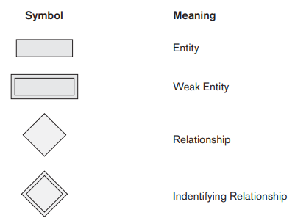
ER Diagrams, Naming Conventions, and Design Issues
Chapter 3-<number>

Slide 62
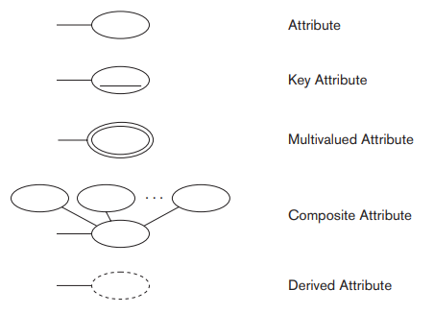
ER Diagrams, Naming Conventions, and Design Issues
Chapter 3-<number>

Slide 63
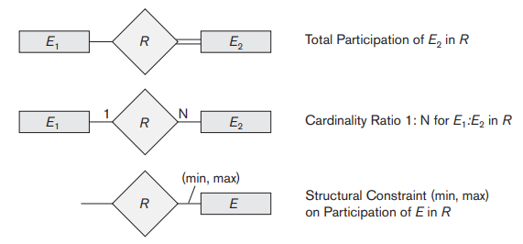
ER Diagrams, Naming Conventions, and Design Issues
Chapter 3-<number>

Slide 64
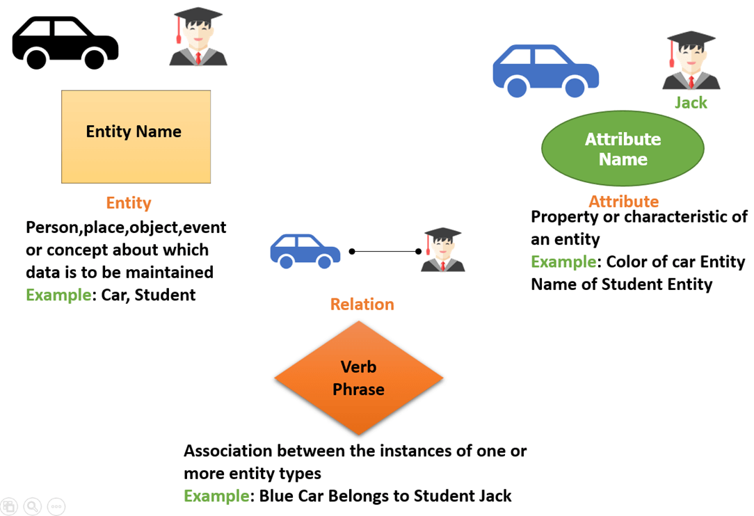
Components of the ER Diagram
This model is based on three basic concepts:

Slide 65
Entities and Attributes
Entity
  Thing in real world with independent existence
Attributes
  Particular properties that describe entity
  Types of attributes:
    Composite versus simple (atomic) attributes
    Single-valued versus multivalued attributes
    Stored versus derived attributes
    NULL values
    Complex attributes

Slide 66
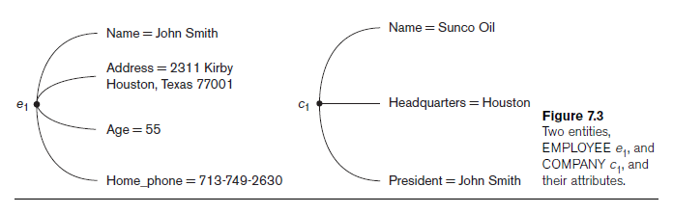
Entities and Attributes (cont’d.)

Slide 67
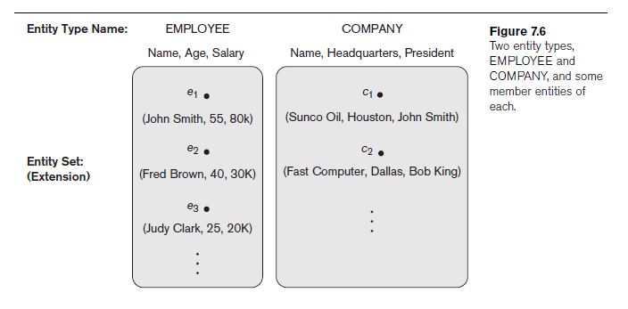
Entity Types, Entity Sets, Keys, and Value Sets
Entity type
  Collection (or set) of entities that have the same attributes

Slide 68
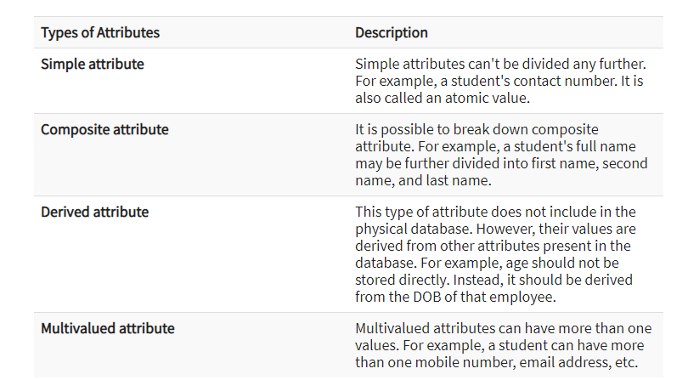
Types of Attributes

Slide 69
Entity Types, Entity Sets, Keys, and Value Sets (cont’d.)
Key or uniqueness constraint
  Attributes whose values are distinct for each individual entity in entity set
  Key attribute
    Uniqueness property must hold for every entity set of the entity type
Value sets (or domain of values)
  Specifies set of values that may be assigned to that attribute for each individual entity

Slide 70
What are Keys in DBMS?
KEYS in DBMS is an attribute or set of attributes which helps you to identify a row(tuple) in a relation(table).
They allow you to find the relation between two tables. Keys help you uniquely identify a row in a table by a combination of one or more columns in that table.
Key is also helpful for finding unique record or row from the table.

Slide 71
Types of Keys
Super Key
Primary Key
Candidate Key
Alternate Key

Slide 72
Types of Keys
Foreign Key
Compound Key
Composite Key

Slide 73
A Sample Database Application
COMPANY
  Employees, departments, and projects
  Company is organized into departments
  Department controls a number of projects
  Employee: store each employee’s name, Social Security number, address, salary, sex (gender), and birth date
  Keep track of the dependents of each employee

Slide 74
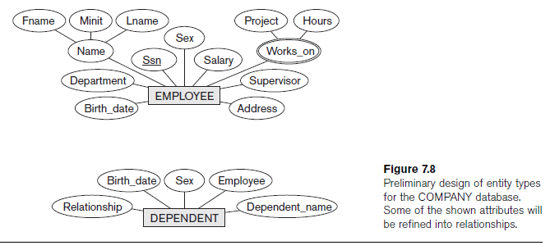
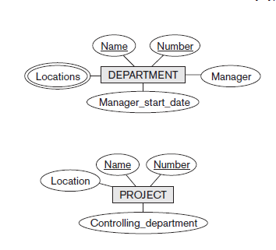
Initial Conceptual Design of the COMPANY Database

Slide 75
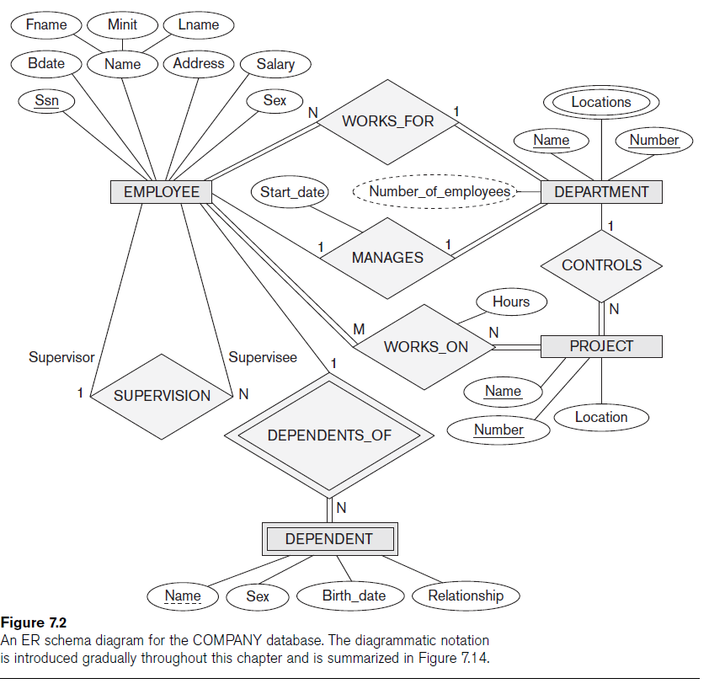

Slide 76
Relationship Types, Relationship Sets, Roles, and Structural Constraints
Relationship
  When an attribute of one entity type refers to another entity type
  Represent references as relationships not attributes

Slide 77
Relationship Types, Sets, and Instances
Relationship type R among n entity types E₁, E₂, ..., E_{n}
  Defines a set of associations among entities from these entity types
A Relationship Type is a type of association that can exist between two different (or same) entity types.Relationship instances r_{i}
  Each r_{i} associates n individual entities (e₁, e₂, ..., e_{n})
  Each entity e_{j} in r_{i} is a member of entity set E_{j}

Slide 78
Relationship Degree
Degree of a relationship type
  Number of participating entity types
  Binary, ternary,unary

Slide 79
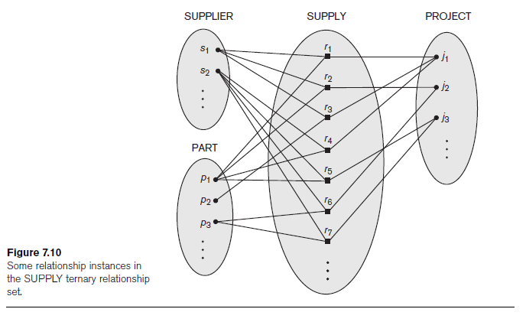

Slide 80
Role Names and Recursive Relationships
Role names and recursive relationships
  Role name signifies role that a participating entity plays in each relationship instance
Recursive relationships
  Same entity type participates more than once in a relationship type in different roles
  Must specify role name

Slide 81
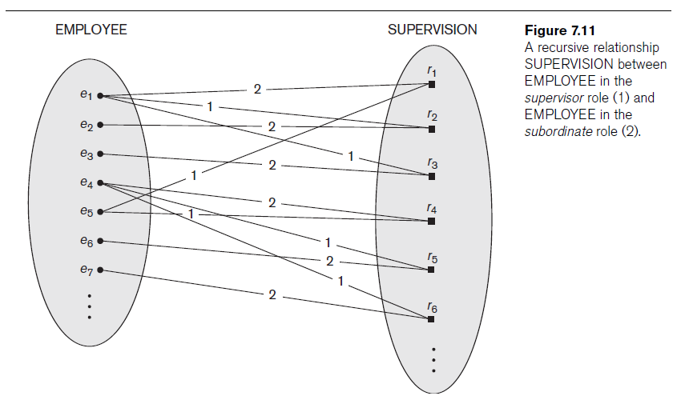

Slide 82
Constraints on Binary Relationship Types
Cardinality ratio for a binary relationship
  Specifies maximum number of relationship instances that entity can participate in
Participation constraint
  Specifies whether existence of entity depends on its being related to another entity
  Types: total and partial

Slide 83
Attributes of Relationship Types
Attributes of 1:1 or 1:N relationship types can be migrated to one entity type
For a 1:N relationship type
  Relationship attribute can be migrated only to entity type on N-side of relationship
For M:N relationship types
  Some attributes may be determined by combination of participating entities
  Must be specified as relationship attributes

Slide 84
Weak Entity Types
Do not have key attributes of their own
  Identified by being related to specific entities from another entity type
Identifying relationship
  Relates a weak entity type to its owner
Always has a total participation constraint

Slide 85
Refining the ER Design for the COMPANY Database
Change attributes that represent relationships into relationship types
Determine cardinality ratio and participation constraint of each relationship type

Slide 86
Proper Naming of Schema Constructs
Choose names that convey meanings attached to different constructs in schema
Nouns give rise to entity type names
Verbs indicate names of relationship types
Choose binary relationship names to make ER diagram readable from left to right and from top to bottom

Slide 87
Alternative Notations for ER Diagrams
Specify structural constraints on relationships
  Replaces cardinality ratio (1:1, 1:N, M:N) and single/double line notation for participation constraints
  Associate a pair of integer numbers (min, max) with each participation of an entity type E in a relationship type R, where 0 ≤ min ≤ max and max ≥ 1

Slide 88
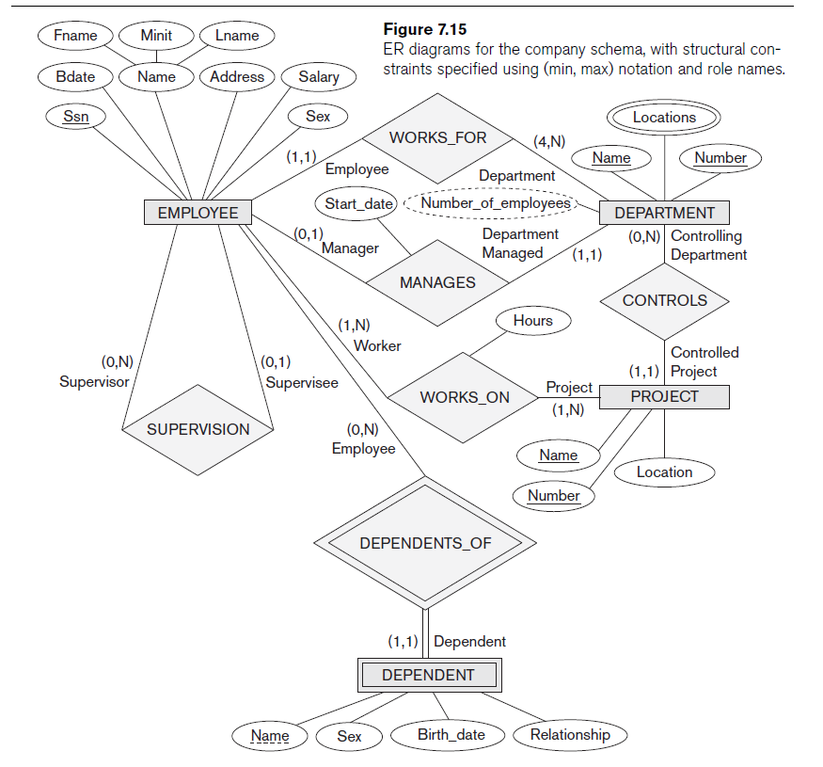

Slide 89
Relationship Types of Degree Higher than Two
Degree of a relationship type
  Number of participating entity types
Binary
  Relationship type of degree two
Ternary
  Relationship type of degree three

Slide 90
Choosing between Binary and Ternary (or Higher-Degree) Relationships
Some database design tools permit only binary relationships
  Ternary relationship must be represented as a weak entity type
  No partial key and three identifying relationships
Represent ternary relationship as a regular entity type
  By introducing an artificial or surrogate key

Slide 91
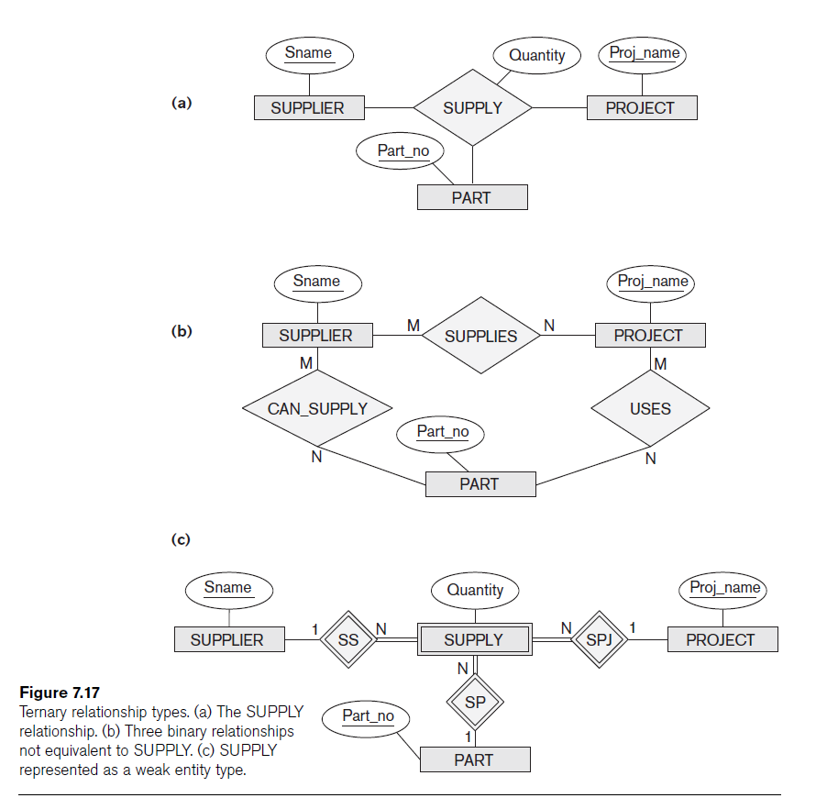

Slide 92
Constraints on Ternary (or Higher-Degree) Relationships
Notations for specifying structural constraints on n-ary relationships
  Should both be used if it is important to fully specify structural constraints

Slide 93
Summary
Basic ER model concepts of entities and their attributes
  Different types of attributes
  Structural constraints on relationships
ER diagrams represent E-R schemas
UML class diagrams relate to ER modeling concepts

Slide 94
Components of ER Diagram
You base an ER Diagram on three basic concepts:
Entities
  Weak Entity
Attributes
  Key Attribute
  Composite Attribute
  Multivalued Attribute
  Derived Attribute
Relationships
  One-to-One Relationships
  One-to-Many Relationships
  Many-to-One Relationships
  Many-to-Many Relationships

Slide 95
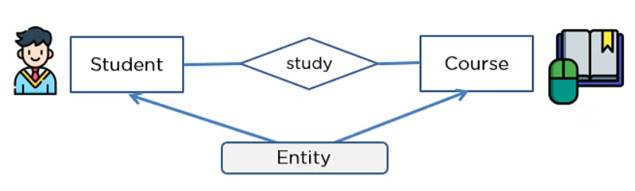
Components of ER Diagram
Entities
An entity can be either a living or non-living component.
It showcases an entity as a rectangle in an ER diagram.
For example, in a student study course, both the student and the course are entities.

Slide 96
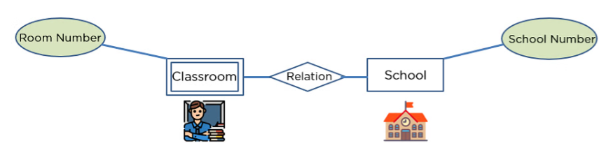
Components of ER Diagram
Weak Entity
An entity that makes reliance over another entity is called a weak entity
You showcase the weak entity as a double rectangle in ER Diagram.
In the example below, school is a strong entity because it has a primary key attribute - school number. Unlike school, the classroom is a weak entity because it does not have any primary key and the room number here acts only as a discriminator.

Slide 97
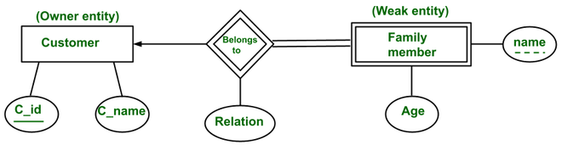
Components of ER Diagram
Identifying Relationships
It links the strong and weak entity and is represented by a double diamond sign.
Chapter 3-<number>

Slide 98
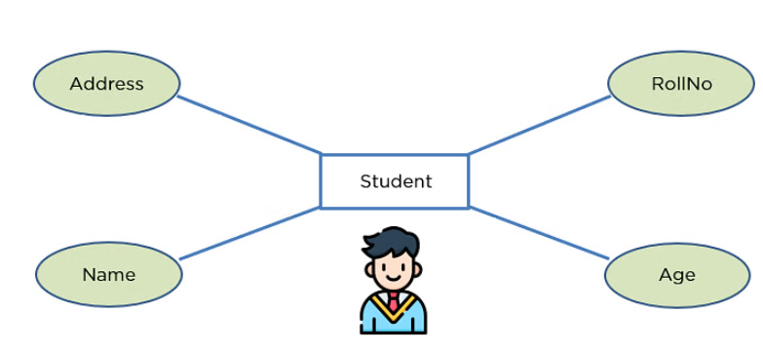
Components of ER Diagram
Attribute
An attribute exhibits the properties of an entity.
You can illustrate an attribute with an oval shape in an ER diagram.

Slide 99
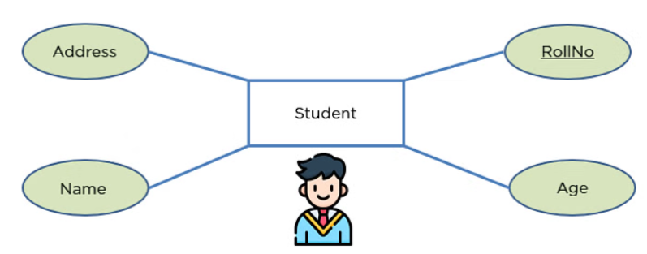
Components of ER Diagram
Key Attribute
Key attribute uniquely identifies an entity from an entity set.
It underlines the text of a key attribute.
For example: For a student entity, the roll number can uniquely identify a student from a set of student

Slide 100
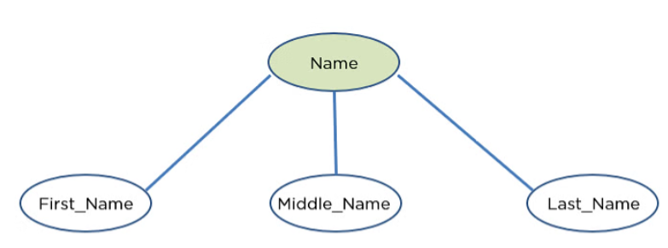
Components of ER Diagram
Composite Attribute
An attribute that is composed of several other attributes is known as a composite attribute.
An oval showcases the composite attribute, and the composite attribute oval is further connected with other ovals.

Slide 101
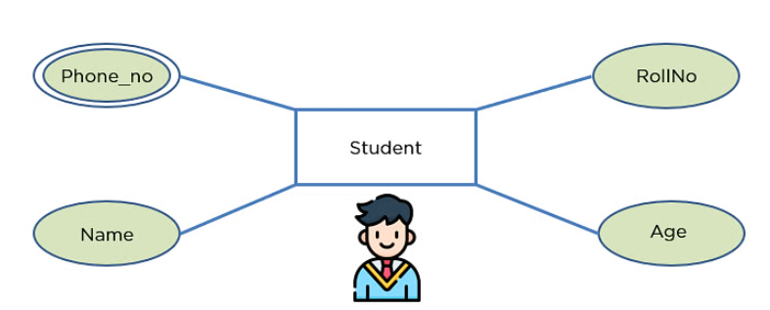
Components of ER Diagram
Multivalued Attribute
Some attributes can possess over one value, those attributes are called multivalued attributes.
The double oval shape is used to represent a multivalued attribute.

Slide 102
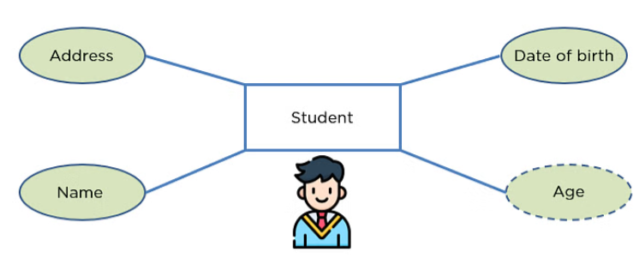
Components of ER Diagram
Derived Attribute
An attribute that can be derived from other attributes of the entity is known as a derived attribute.
In the ER diagram, the dashed oval represents the derived attribute.

Slide 103
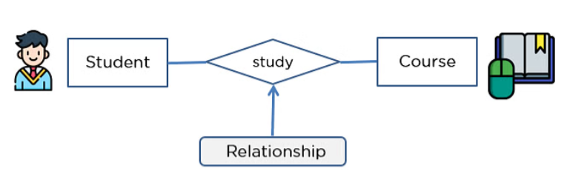
Components of ER Diagram
Relationship
The diamond shape showcases a relationship in the ER diagram.
It depicts the relationship between two entities.
In the example below, both the student and the course are entities, and study is the relationship between them.

Slide 104

Components of ER Diagram
Many-to-One Relationship
When more than one element of an entity is related to a single element of another entity, then it is called a many-to-one relationship.
For example, students have to opt for a single course, but a course can have many students

Slide 105

Components of ER Diagram
Many-to-Many Relationship
When more than one element of an entity is associated with more than one element of another entity, this is called a many-to-many relationship.
For example, you can assign an employee to many projects and a project can have many employees.

Slide 106
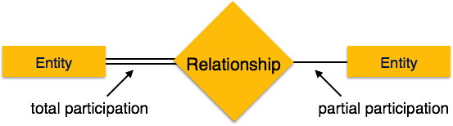
Components of ER Diagram
Participation Constraints
Total Participation − Each entity is involved in the relationship. Total participation is represented by double lines.
Partial participation − Not all entities are involved in the relationship. Partial participation is represented by single lines.

Slide 107
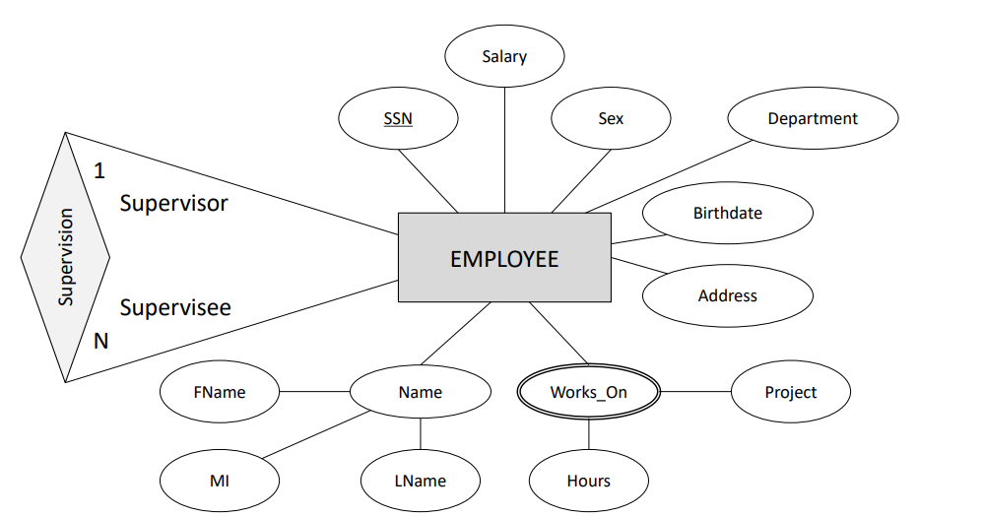

Slide 108
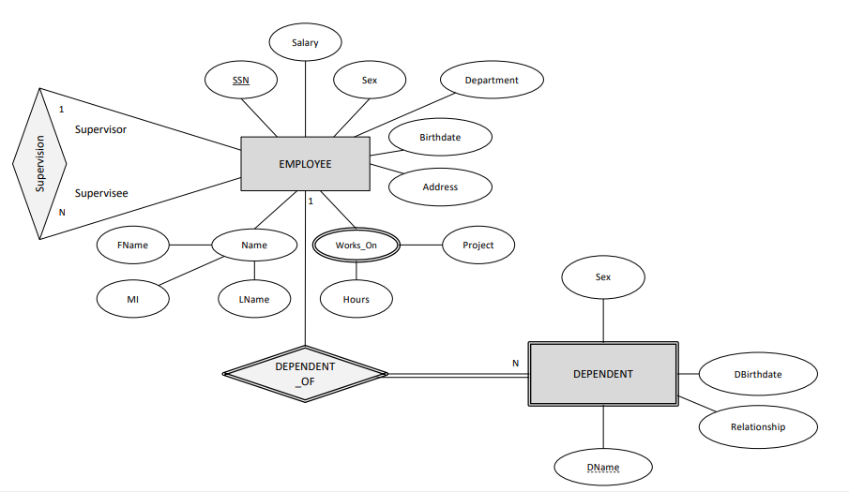

Slide 109
The (min,max) notation relationship constraints
(0,1)
(1,1)
Employee
Manages
Department
(1,1)
(1,N)
Employee
Department
Works-for

Slide 110
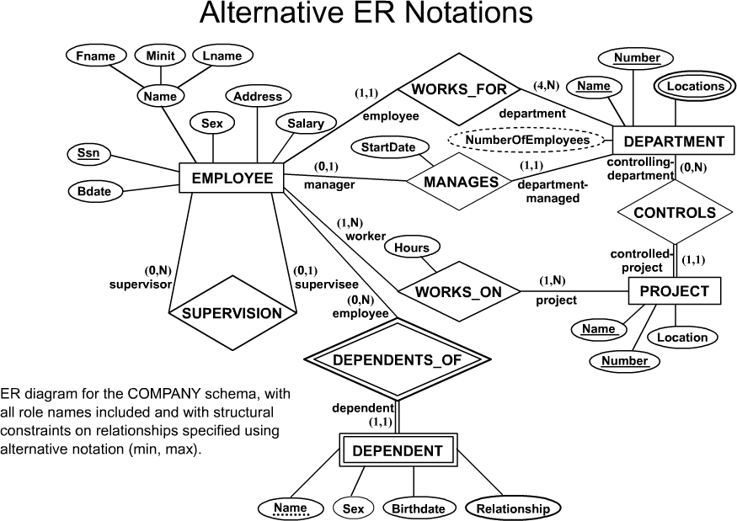
COMPANY ER Schema Diagram using (min, max) notation

Slide 111
Data Modeling Tools
A number of popular tools that cover conceptual modeling and mapping into relational schema design. Examples:
  ERWin,
  S- Designer (Enterprise Application Suite),
  ER- Studio, etc.
POSITIVES: serves as documentation of application requirements, easy user interface - mostly graphics editor support

Slide 112
Problems with Current Modeling Tools
DIAGRAMMING
  Poor conceptual meaningful notation.
  To avoid the problem of layout algorithms and aesthetics of diagrams, they prefer boxes and lines and do nothing more than represent (primary-foreign key) relationships among resulting tables.(a few exceptions)
METHODOLGY
  lack of built-in methodology support.
  poor tradeoff analysis or user-driven design preferences.
  poor design verification and suggestions for improvement.

Slide 113
PROBLEM with ER notation
The entity relationship model in its original form did not support the specialization/ generalization abstractions

Slide 114
Extended E-R Features

Slide 115
Generalization & Specialization
Shows inheritance of attributes.
A lower-level entity set inherits all the attributes and relationship participation of the higher-level entity set to which it is linked.
A lower-level entity set may have additional attributes and participate in additional relationships.
Also knows as Superclass-Subclass relationship.

Slide 116

Specialization
Generalization

Slide 117
More E-R Diagram Examples
Koushik De- - CSE, UEMK

Slide 118
Problem
Draw an ER model of the Banking database application considering the following constraints −
  A bank has many entities.
  Each customer has multiple accounts.
  Multiple customers belong to a single branch.
  Single customer can borrow multiple loans.
  A branch has multiple employees.

Slide 119
Solution
Follow the steps given below to draw an ER model of the Banking database application −
Step 1 − Identify the entity sets
  The entity set has multiple instances in a given business scenario.
  As per the given constraints the entity sets are as follows
  Customer
  Account
  Branch
  Loan
  Employee

Slide 120
Step 2 − Identify the attributes for the given entities
Customer − the relevant attributes are customerName, CustomerID, address.
Account − The relevant attributes are AccountNo, balance.
Branch − The relevant attributes are branchID, branchName, address.
Loan − The relevant attributes are loanNo, paymentMode, dateOfLoan, and amount.
Employee − The relevant attributes are empID, empName, dateOfJoin, experience, qualification.

Slide 121
Step 3 − Identify the Key attributes
CustomerID is the key attribute for a customer.
AccountNo is the key attribute for Account entities.
BranchID is the key attribute for branch entities.
LoanNo is the key attribute for a loan entity.
EmpID is the key attribute for an Employee entity.

Slide 122
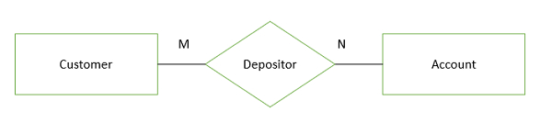
Step 4 − Identify the relationship between entity sets
One customer is enrolled by multiple accounts and one account for multiple customers. Hence, the relationship is many to many.

Slide 123
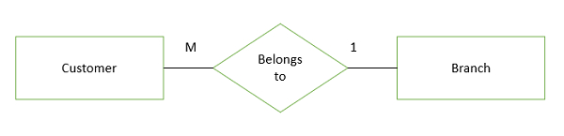
Step 4 − Identify the relationship between entity sets (Cont…)
Many customers belong to one branch but one branch belongs to many customers. Hence, the relationship between customer and branch is many to one.

Slide 124
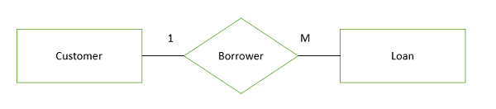
Step 4 − Identify the relationship between entity sets (Cont…)
One customer can borrow multiple loans in the same way multiple loans can borrow a single customer, hence the relationship between customer and loan is one to many.

Slide 125
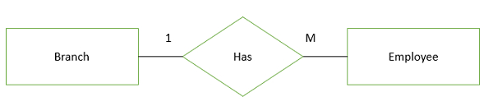
Step 4 − Identify the relationship between entity sets (Cont…)
One branch has many employees and in the same way the number of employees works in a single branch.

Slide 126
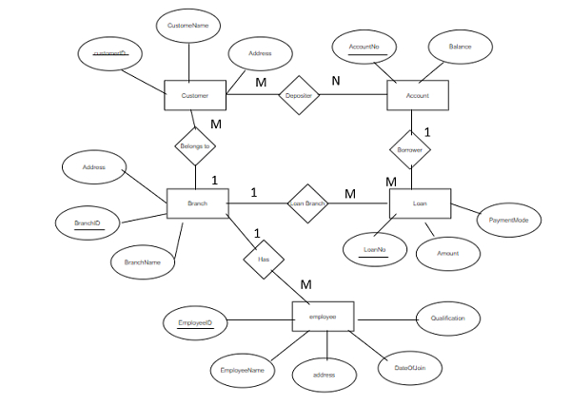
Step 5 − Complete ER diagram
The complete ER diagram is as follows −

Slide 127

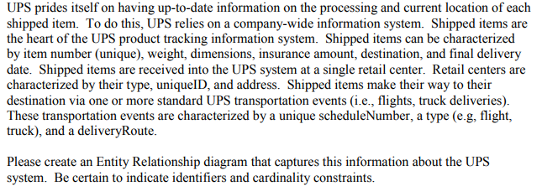
Assignment

Slide 128
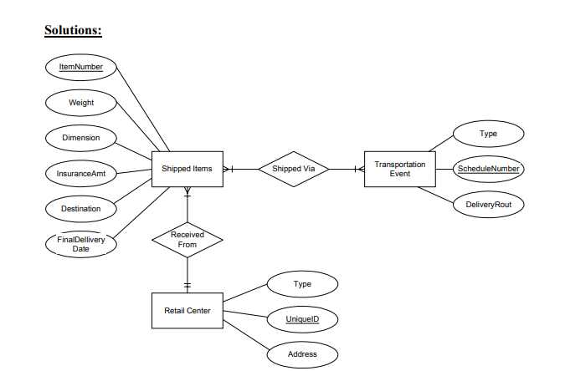

Slide 129
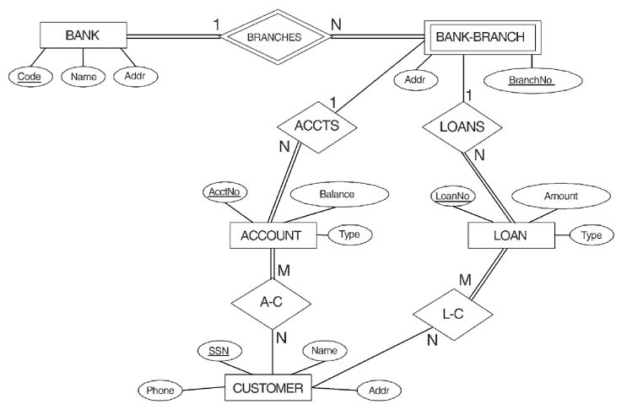
ER DIAGRAM FOR A BANK
DATABASE
© The Benjamin/Cummings Publishing Company, Inc. 1994, Elmasri/Navathe, Fundamentals of Database Systems, Second Edition
Chapter 3-<number>

Slide 130
ER DIAGRAM FOR A BANK
DATABASE
© The Benjamin/Cummings Publishing Company, Inc. 1994, Elmasri/Navathe, Fundamentals of Database Systems, Second Edition
Chapter 3-<number>

Slide 131

Koushik De- - CSE, UEMK

Slide 132

Koushik De- - CSE, UEMK

Slide 133
2.Relational Algebra
The relational algebra is a procedural query language. Relational algebra is the basic set of operations for the relational model
It consists of a set of operations that take one or two relations as input and produce a new relation as their result.
Six basic operators
  select: σ
  project: ∏
  union: ∪
  set difference: –
  Cartesian product: x
  rename: ρ

Slide 134
Relational Algebra Overview
Relational Algebra consists of several groups of operations
Unary Relational Operations
  SELECT (symbol: s (sigma))
  PROJECT (symbol: p (pi))
  RENAME (symbol: r (rho))
Relational Algebra Operations From Set Theory
  UNION (È), INTERSECTION (Ç ), DIFFERENCE (or MINUS, – )
  CARTESIAN PRODUCT ( x )
Binary Relational Operations
  JOIN (several variations of JOIN exist)
  DIVISION
Additional Relational Operations
  OUTER JOINS, OUTER UNION
  AGGREGATE FUNCTIONS (These compute summary of information: for example, SUM, COUNT, AVG, MIN, MAX)

Slide 135

Project Operation
Project is used to display the required attributes from a relation.
Notation:
where A₁, A₂ are attribute names and r is a relation name.
The result is defined as the relation of k columns obtained by erasing the columns that are not listed
Duplicate rows removed from result, since relations are sets
Example:
To list all instructors’ ID, name, and salary attributes of instructor
∏_{ID, name, salary} (instructor)
Find the name of all instructors in the Physics department
∏name (σ dept name =“Physics” (instructor))

Slide 136
Select Operation
The select operation selects tuples that satisfy a given predicate.
Notation: σ _{p}(r)
p is called the selection predicate
The selection condition acts as a filter
comparisons are done using =, ≠, <, ≤, >, and ≥ in the selection
predicate.
we can combine several predicates into a larger predicate by using the connectives and (∧), or (∨), and not (￢)
Example of selection:
1. To select tuples of the instructor who is in the “Physics” department
σ _{dept_name=“Physics”}(instructor)
2. find all instructors with salary greater than 90,000
σ _{salary>90000}(instructor)
3. to find the instructors in Physics with a salary greater than $90,000
σ dept name =“Physics”∧salary>90000 (instructor )

Slide 137
RENAME
The RENAME operator is denoted by r (rho)
We may rename the attributes of a relation or the relation name or both
The general RENAME operation r can be expressed
by any of the following forms:
■ rS (B1, B2, …, Bn )(R) changes both:
  ■ the relation name to S, and
  ■ the column (attribute) names to B1, B1, …..Bn
■ rS(R) changes:
  ■ the relation name only to S
■ r(B1, B2, …, Bn )(R) changes:
  ■ the column (attribute) names only to B1, B1, …..Bn

Slide 138
Cartesian-Product Operation
The Cartesian-product operation, denoted by a cross (×), allows us to combine information from any two relations.
Cartesian product of relations r1 and r2 is written as r1 × r2.
Ex: to find the names of all instructors in the Physics department together with the course id of all courses they taught.

Slide 139
Union Operation
Notation: r ∪ s
Defined as:
r ∪ s = {t | t ∈ r or t ∈ s}
The result of this operation, denoted by R ∪ S, is a relation that includes all tuples that are either in R or in S or in both R and S. Duplicate tuples are eliminated.
For r ∪ s to be valid (r and s should be union compatible).
1. r, s must have the same arity (same number of attributes)
2. The attribute domains must be compatible (example: 2nd column
of r deals with the same type of values as does the 2nd
column of s)
Example: to find all courses taught in the Fall 2009 semester, or in the Spring 2010 semester, or in both
∏_{course_id} (σ _{semester=“Fall” Λ year=2009} (section)) ∪
∏_{course_id} (σ _{semester=“Spring” Λ year=2010} (section))

Slide 140
Intersection Operation
Notation: r ∩ s
Defined as:
r ∩ s = { t | t ∈ r and t ∈ s }
The result of this operation, denoted by r∩ s, is a relation that includes all tuples that are in both r and s.
Assume:
  r, s have the same arity
  attributes of r and s are compatible
Example: to find all courses taught in the Fall 2009 semester, and in the Spring 2010 semester
∏_{course_id} (σ _{semester=“Fall” Λ year=2009} (section)) ∩
∏_{course_id} (σ _{semester=“Spring” Λ year=2010} (section))

Slide 141
Set Difference Operation
Notation r – s
Defined as:
r – s = {t | t ∈ r and t ∉ s}
Set differences must be taken between compatible relations.
  r and s must have the same arity
  attribute domains of r and s must be compatible
Example: to find all courses taught in the Fall 2009 semester, but not in the Spring 2010 semester
∏_{course_id} (σ _{semester=“Fall” Λ year=2009} (section)) −
∏_{course_id} (σ _{semester=“Spring” Λ year=2010} (section))

Slide 142


Set operations example

Slide 143



Slide 144



Slide 145


Slide 146


Slide 147
Join / Cartesian Product
Binary Operation between two relation A and B
The operator generates all possible combination between all tuples of A and B
Denoted by ‘× ‘
Properties of Join operation
Given two relation A and B with :
degree(A) = m degree(B)=n
cardinality(A)= c1 cardinality(B)=c2
Then
degree(A×B) = degree(A)+ degree(B)=>m+n
cardinality(A×B) = cardinality(c1) * cardinality(c2) => c1*c2
A×B
A
B
P | Q | M | N
p1 | q1 | m1 | n1
p1 | q1 | m2 | n2
p1 | q1 | m3 | n3
p2 | q2 | m1 | n1
p2 | q2 | m2 | n2
p2 | q2 | m3 | n3
P | Q
p1 | q1
p2 | q2
M | N
m1 | n1
m2 | n2
m3 | n3

Slide 148
Join in relational Algebra
Join is a combination of a Cartesian product followed by a selection process.
A Join operation pairs two tuples from different relations, if and only if a given join condition is satisfied.
Various forms of join operation are:
Inner Joins:
Theta join
EQUI join
Natural join
Outer join:
Left Outer Join
Right Outer Join
Full Outer Join
Inner Join:
In an inner join, only those tuples that satisfy the matching criteria are included, while the rest are excluded.

Slide 149


Slide 150


Slide 151


Slide 152


Slide 153


Slide 154


LEFT JOIN ( )
This join returns all the rows of the table on the left side of the join and matching rows for the table on the right side of join.
The rows for which there is no matching row on right side, the result-set will contain null.
LEFT JOIN is also known as LEFT OUTER JOIN
id | Name | Marks
10 | Jay | NULL
20 | Veer | 18
30 | John | 14

Slide 155


RIGHT JOIN( )
RIGHT JOIN is similar to LEFT JOIN.
This join returns all the rows of the table on the right side of the join and matching rows for the table on the left side of join.
The rows for which there is no matching row on left side, the result-set will contain null.
RIGHT JOIN is also known as RIGHT OUTER JOIN
id | name | marks
Null | Rohan | 20
20 | Veer | 18
30 | John | 14
Null | Sam | 13

Slide 156
FULL JOIN ( )
FULL OUTER JOIN creates the result-set by combining result of both LEFT JOIN and RIGHT JOIN.
The result-set will contain all the rows from both the tables.
The rows for which there is no matching, the result-set will contain NULL values.
ID | Name | Marks
10 | Jay | NULL
20 | Veer | 18
30 | John | 14
NULL | Rohan | 20
Null | Sam | 13
Table A
Table B

Slide 157
OUTER UNION Operations
The outer union operation was developed to take the union of tuples from two relations if the relations are not type compatible.
This operation will take the union of tuples in two relations R(X, Y) and S(X, Z) that are partially compatible, meaning that only some of their attributes, say X, are type compatible.
The attributes that are type compatible are represented only once in the result, and those attributes that are not type compatible from either relation are also kept in the result relation T(X, Y, Z).

Slide 158
Division ÷
Binary Operation between two relation C and B
Implicitly C is A × B where A is any Relation
C÷B => (A × B) ÷ B
The operator ‘÷ ‘ splits B from C and produces A
e.g C÷B=>
C= A × B B A
P | Q | M | N
p1 | q1 | m1 | n1
p1 | q1 | m2 | n2
p1 | q1 | m3 | n3
p2 | q2 | m1 | n1
p2 | q2 | m2 | n2
p2 | q2 | m3 | n3
M | N
m1 | n1
m2 | n2
m3 | n3
P | Q
p1 | q1
p2 | q2

Slide 159
Division operation will return the result which is from A ,which are associated with every tuple in B.

Slide 160

Division ÷
Student Subject TestQP(Student ×Subject)
120 combinations
p
1
2
3
..
60
DBMS
COA
1
2
..
60
DBMS
COA
TestQP(Student ×Subject)
Student
Subject(TestQP ÷ Student)
1,DBMS
1,COA
2,DBMS
2,COA
….
60,DBMS
60,COA
1
2
3
..
60

Slide 161

Division ÷
Student(TestQP ÷ Subject)
TestQP(Student ×Subject)
Subject
1,DBMS
1,COA
2,DBMS
2,COA
….
60,DBMS
60,COA
1
2
3
..
60

Slide 162
Division ÷
Formal examples:
Cases :
Case 1:
Given A,B,C are relations and X,Y are attributes
C(X,Y) ÷ A(X) => B(Y)
C(X,Y) ÷ A(Y) => B(X)
Case 2:
÷ =
÷
÷
X | Y
X1 | Y1
X2 | Y2
X1 | Y2
X4 | y4
Y
Y1
Y2
X
X1

Slide 163
Division ÷
Formal examples:
Case 3:
÷ =
Case 4:
÷ =
X | Y
X1 | Y1
X2 | Y2
X1 | Y2
X4 | y4
X
X1
Y
Y1
Y2
X | Y
X1 | Y1
X2 | Y2
X1 | Y2
X4 | y4
Y
Y1
Y2
Y3
Y4
X
Null

Slide 164
Division ÷
Formal examples:
Case 5:
÷ =
Case 6:
÷ =
X | Y
X1 | Y1
X2 | Y1
X3 | Y1
X4 | y1
Y
Y1
x
X1
X2
X3
X4
X | Y
X1 | Y1
X2 | Y1
X2 | Y2
X1 | y2
Y
Y1
Y2
X
X1
X2

Slide 165

Recap of Relational Algebra Operations

Slide 166

Aggregate Function Operation
We can define an AGGREGATE FUNCTION operation, using the symbol ℑ (pronounced script F), to specify these types of requests as follows:
where <grouping attributes> is a list of attributes of the relation specified in R, and <function list> is a list of (<function> <attribute> ) pairs.
In each such pair, <function> is one of the allowed functions—such as SUM, AVERAGE, MAXIMUM, MINIMUM, COUNT—and is an attribute of the relation specified by R

Slide 167
Aggregate Function Operation
Use of the Aggregate Functional operation ℱ
■ ℱMAX Salary (EMPLOYEE) retrieves the maximum salary value
from the EMPLOYEE relation
■ ℱMIN Salary (EMPLOYEE) retrieves the minimum Salary value
from the EMPLOYEE relation
■ ℱSUM Salary (EMPLOYEE) retrieves the sum of the Salary from
the EMPLOYEE relation
■ ℱCOUNT SSN, AVERAGE Salary (EMPLOYEE) computes the count (number) of employees and their average salary
■ Note: count just counts the number of rows, without removing duplicates

Slide 168




Examples of applying aggregate functions and grouping

Slide 169




Slide 171




Slide 172

Examples of Queries in Relational Algebra
Query 1. Retrieve the name and address of all employees who work for the ‘Research’ department.

Slide 173

Query 2. For every project located in ‘Stafford’, list the project number, the controlling department number, and the department manager’s last name, address, and birth date.

Slide 174

Query 3. List the names of managers who have at least one dependent.

Slide 175

Query 4. Find the names of employees who work on all the projects controlled by department number 5.

Slide 176


Query 5. Make a list of project numbers for projects that involve an employee whose last name is ‘Smith’, either as a worker or as a manager of the department that controls the project.

Slide 177

Query 6. List the names of all employees with two or more dependents.

Slide 178

Query 7. Retrieve the names of employees who have no dependents.

Slide 179
Thank YOU

